Slide 1

Software Engineering
Software processes

Slide 2
The Software Process
A structured set of activities required to develop a
software system
  Specification
  Analysis, design and implementation.
  Validation
  Evolution
A software process model is an abstract representation of a process
  It presents a description of a process from some particular perspective

Slide 3
Software Development Approaches
Generic Software Process Models
  The waterfall model (Linear Sequential Model)
    Separate and distinct phases of specification and development
  Evolutionary development
    Specification, development and testing are interleaved
Formal systems development (example - ASML)
  A mathematical system model is formally transformed to an implementation

Slide 4
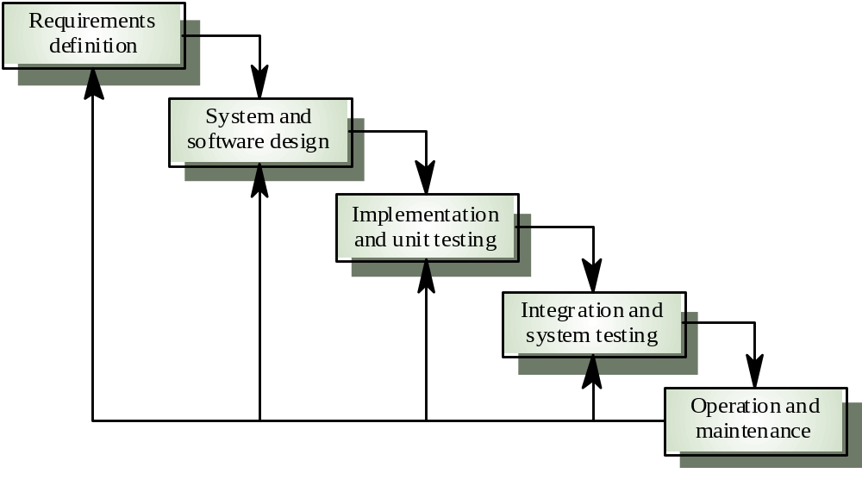
Waterfall Model

Slide 5
Waterfall model phases
Requirements analysis and definition
System and software design
Implementation and unit testing
Integration and system testing
Operation and maintenance
The drawback of the waterfall model is the difficulty of accommodating change after the process is underway

Slide 6
Waterfall model Requirement and Design
Artefacts produced in the requirements and Design phases
SRS -Software Requirements specification document
SRS might include:
  User usage stories (scenarios) – Use cases.
  Static analysis – class diagrams.
  Behavioural analysis – sequence diagrams, statecharts.

Slide 7
The requirements document
The requirements document is the official statement of what is required of the system developers.
Should include both a definition of user requirements and a specification of the system requirements.
It is NOT a design document. As far as possible, it should set of WHAT the system should do rather than HOW it should do it

Slide 8
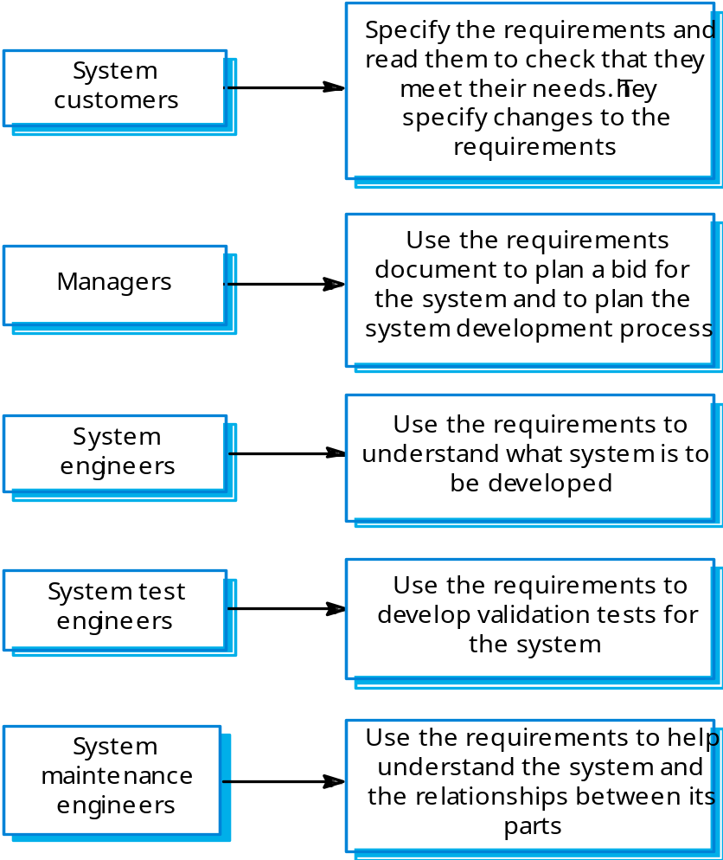
Users of a requirements document

Slide 9
The Waterfall process characterization:
Figure out what
Figure out how
Then do it
Verify was done right
Hand product to customer
Perfect requirement definition?
Notes:
It is hard to come up with a perfect requirements definition.
It was common to discover in the design phase that the requirements were not consistent or that a small change in the requirements would lead to a system that was both easier to design and more useful for the customer, but the analysis phase was over, so the designers had no choice – they had to take the existing requirements errors and all.
This problem would repeat itself during implementation.
The deisgners thought they knew how to solve the problem as efficiently as possible, but when the design was actually implemented, it turned out tha the resulting program was not as fast as the designers had thought.
The next transition is one with which you are surely familiar.
When the prrogram was handed to the quality assurance department for testing, many bugs were found that would best be fixed by reimplementing, or manybe even redesigning the program, but the waterfall model did not allow for this.
Finally, when the customers received the finished product, they wre often not at all happy with it. Even though the customers were typically very involved in the analysis phase, often they themselves were not sure exactly what they needed. After all, it can be difficult to describe how you want to use a product that you have never seen before. But when the customers stateed using the program, they began to realise what they would have liked. Of course, then it was too late, and they had to live with what they got.
Having some level of iteration is clearly necessary. There simply muyst be a mechanism to deal with errors from the preceding phase.

Slide 10
Waterfall model problems
Difficult to respond to changing customer requirements
This model is only appropriate when the requirements are well-understood
Waterfall model describes a staged development process
    Based on hardware engineering models
    Change during development is unlikely
    Widely used in large systems: military and aerospace industries

Slide 11
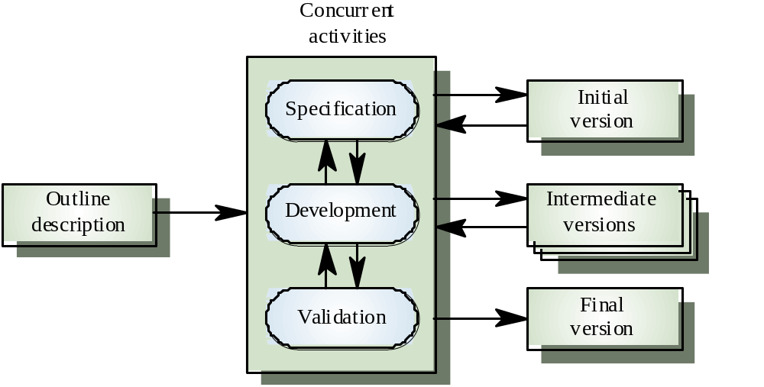
Evolutionary development

Slide 12
Characteristics of Evolutionary Development
Modern development processes take evolution as fundamental, and try to provide ways of managing, rather than ignoring, the risk.
System requirements always evolve in the course of a project.
Specification is evolved in conjunction with the software – No complete specification in the system development contract. Difficult for large customers.
Two (related) process models:
  Incremental development
  Spiral development

Slide 13
Incremental Development
Rather than deliver the system as a single delivery, the development and delivery is broken down into increments with each increment delivering part of the required functionality.
User requirements are prioritised and the highest priority requirements are included in early increments.
Once the development of an increment is started, the requirements are frozen though requirements for later increments can continue to evolve.

Slide 14
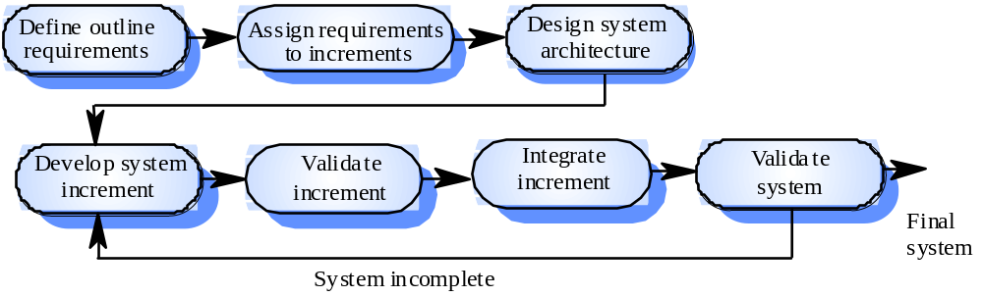
Incremental Development – Version I

Slide 15
Incremental Development –Advantages
Customer value can be delivered with each increment so system functionality is available earlier.
Early increments act as a prototype to help elicit requirements for later increments.
Lower risk of overall project failure.
The highest priority system services
tend to receive the most testing.

Slide 16
Incremental Development – Problems
Lack of process visibility.
Systems are often poorly structured.
Applicability claims in the literature:
  For small or medium-size interactive systems.
  For parts of large systems (e.g. the user interface).
  For short-lifetime systems.

Slide 17
Incremental means adding, iterative means reworking (by Alistair Cockburn)
Incremental development is a staging and scheduling strategy in which the various parts of the system are developed at different times or rates and integrated as they are completed. The alternative is to develop the entire system with a big bang integration at the end.
Iterative development is a rework scheduling strategy in which time is set aside to revise and improve parts of the system. The alternative development is to get it right the first time (or at least declare that it is right!).
http://www.stickyminds.com/BetterSoftware/magazine.asp?fn=cifea&id=108
Iterate | Increment
fundamentally means “change”. | fundamentally means “add onto”.
repeating the process on the same section of work | repeating the process on a new section of work.
repeat the process (, design, implement, evaluate), | repeat the process (, design, implement, evaluate),

Slide 18
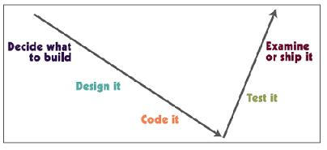
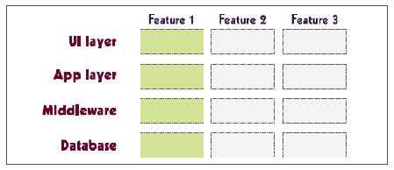
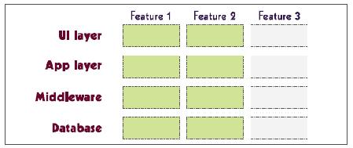
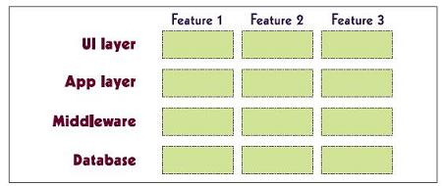
Incremental Development
The first increment delivers one slice of
functionality through the whole system.
The second increment delivers another
slice of functionality through the whole system.
The third increment delivers the rest of
the system

Slide 19
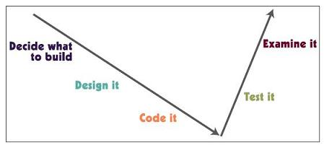
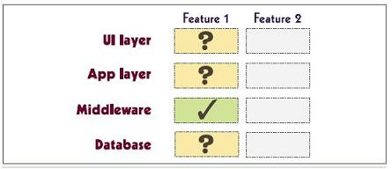
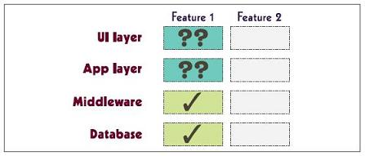
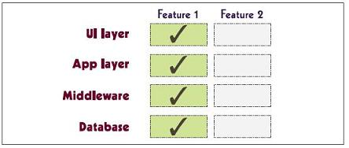
Iterative Development
\
The first iteration delivers enough of
feature 1 to evaluate what is correct
and what needs revision.
After the second iteration, some revised
parts still need improvement.
The third iteration produces the final
and stable feature

Slide 20
Incremental & iterative - summary
Iterative model - This model iterates requirements, design, build and test phases again and again for each requirement and builds up a system iteratively till the system is completely build.
Incremental model - It is non integrated development model. This model divides work in chunks and one team can work on many chunks. It is more flexible.
Spiral model - This model uses series of prototypes in stages, the development ends when the prototypes are developed into functional system. It is flexible model and used for large and complicated projects.
Evolutionary model - It is more customer focused model. In this model the software is divided in small units which is delivered earlier to the customers.
V-Model - It is more focused on testing. For every phase some testing activity are done.

Slide 21
The (Rational) Unified Process
A modern process model derived from the work on the UML.
Normally described from 3 perspectives
  A dynamic perspective that shows phases over time;
  A static perspective that shows process activities;
  A practice perspective that suggests good practice.

Slide 22
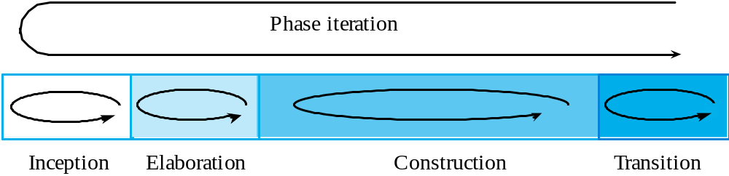
(R)UP phase model

Slide 23
(R)UP phases
One cycle consists of four phases:
  Inception
    Establish the business case for the system.
  Elaboration
    Develop an understanding of the problem domain and the system architecture.
  Construction
    System design, programming and testing.
  Transition
    Deploy the system in its operating environment.

Slide 24
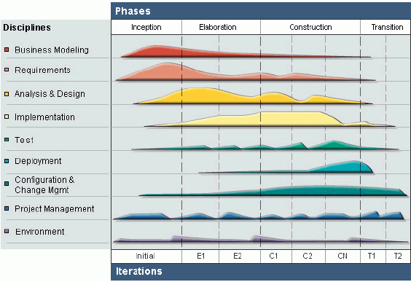
(R)UP phases and iterations
Picture taken from: http://www.ibm.com/developerworks/webservices/library/ws-soa-term2/

Slide 25
(R)UP
In each phase many different workflows (like management, environment, design, implementation workflow, etc.) can be addressed simultaneously.
At the end of each cycle some kind of prototype or artifact are produced.
The phases can be repeated many times (i.e. iterations), producing one or many prototypes or artifacts.
During the cycles the requirements are stable which offers possibilities to plan the development process for this cycle.
Between the cycles the requirements change.

Slide 26
(R)UP good practice
Develop software iteratively
Manage requirements
Use component-based architectures
Visually model software
Verify software quality
Control changes to software

Slide 27
Spiral Development
Process is conceived as a spiral rather than as a sequence of activities with backtracking.
Each loop in the spiral represents a phase in the process.
No fixed phases such as specification or design - loops in the spiral are chosen depending on what is required.
Risks are explicitly assessed and resolved throughout the process.

Slide 28
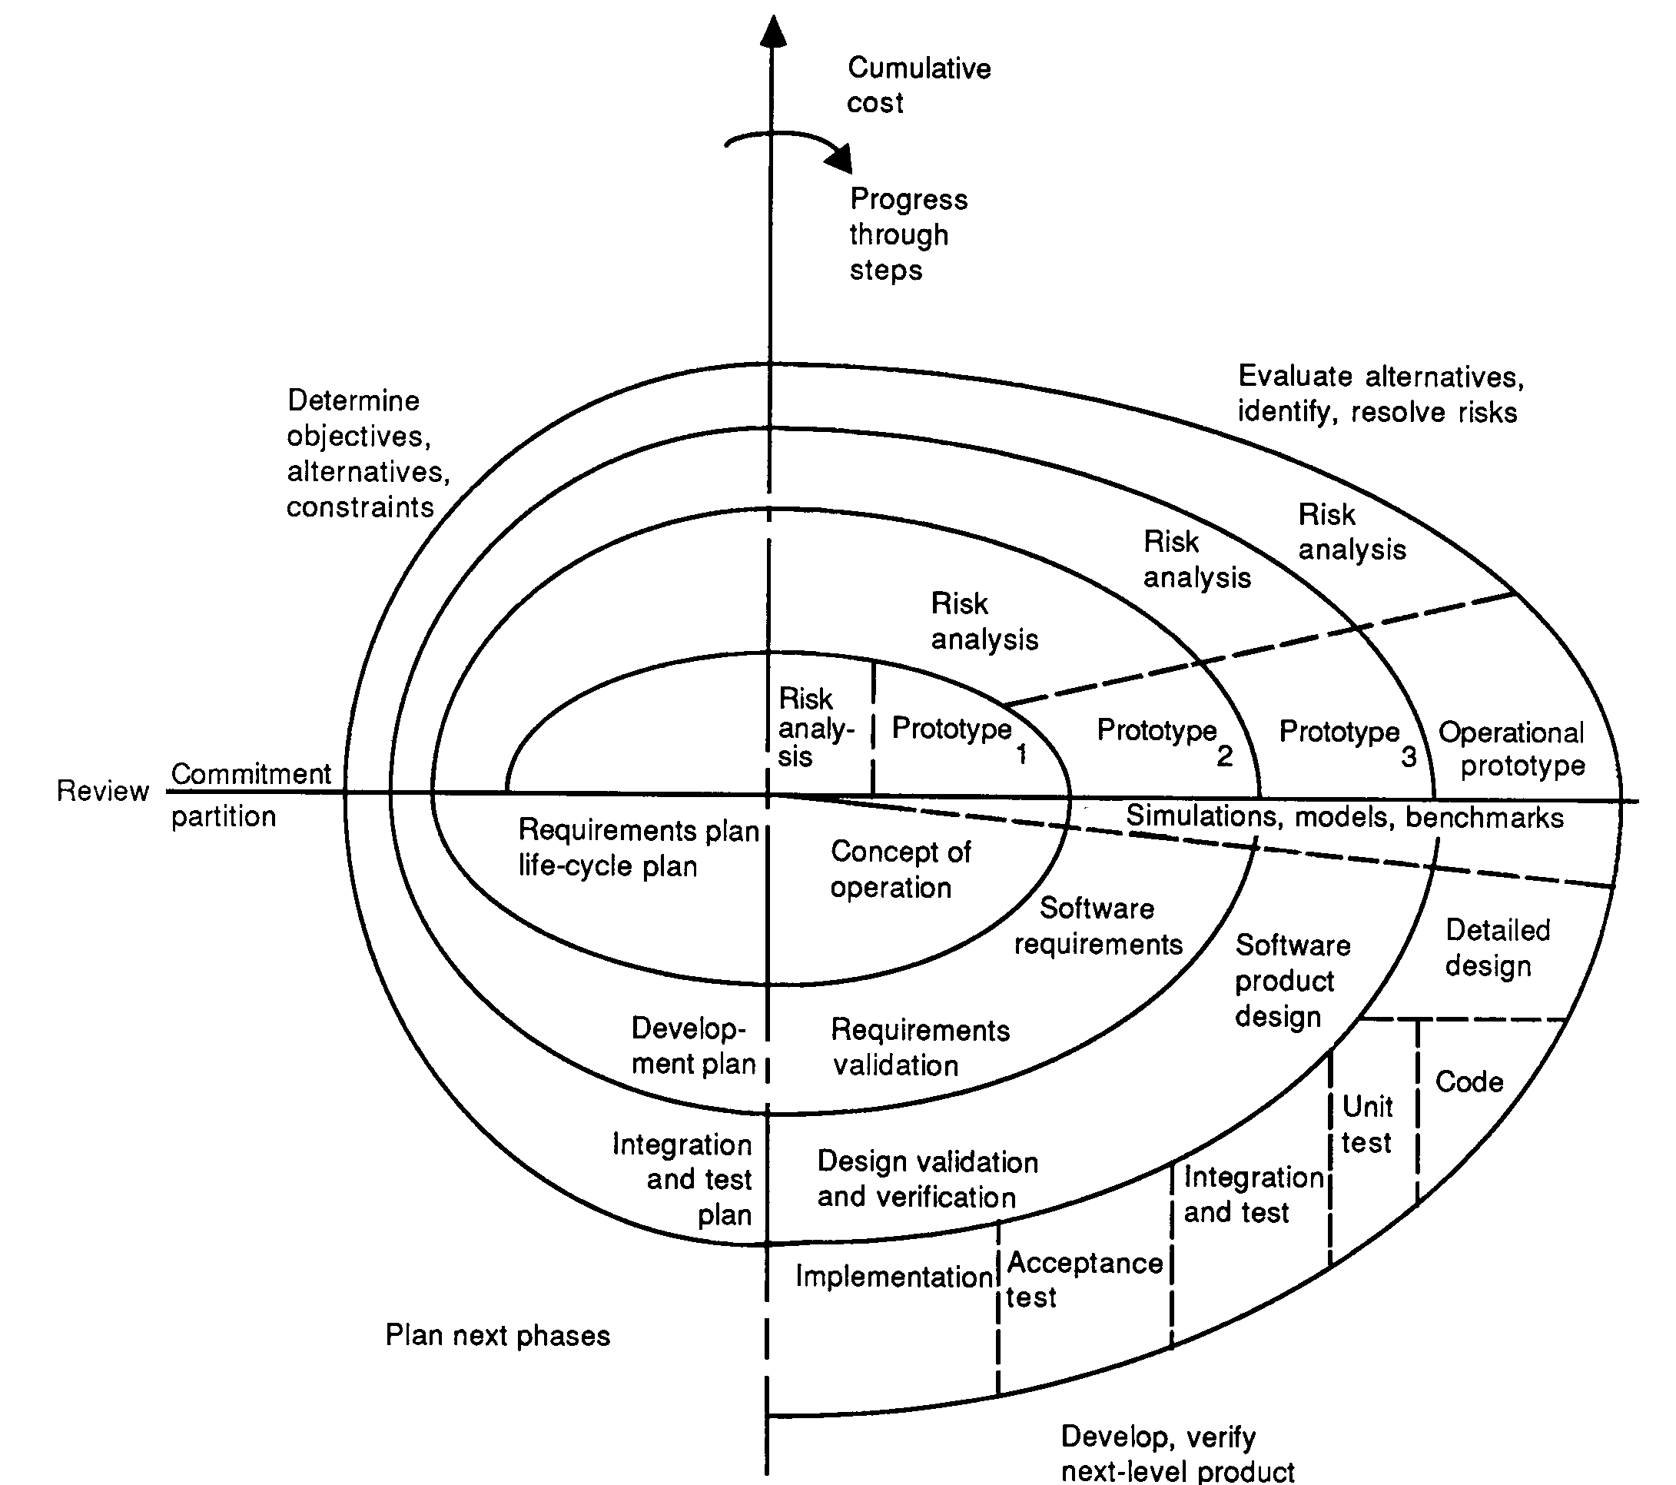
Spiral model (Boehm 87)
Objective setting
Specific objectives for the phase are identified.
Risk assessment and reduction
Risks are assessed and activities put in place to reduce the key risks.
Planning
The project is reviewed and the next phase of the spiral is planned.
Development and validation
A development model for the system is chosen which can be any of the generic models.

Slide 29
Spiral model sectors
Objective setting
  Specific objectives for the phase are identified.
Risk assessment and reduction
  Risks are assessed and activities put in place to reduce the key risks.
Development and validation
  A development model for the system is chosen which can be any of the generic models.
Planning
  The project is reviewed and the next phase of the spiral is planned.

Slide 30
Agile Methods
Result from dissatisfaction with the overheads involved in design methods.
Software Development History:
During the 1970s, it was discovered that most large software development projects failed.
During the 1980s, many of the reasons for those failures began to be recognized.
In the 1990s, experiments and measurements were used to validate individual methods to prevent failure.
The current decade is characterized by complete processes to improve success.

Slide 31
Project Failure – the trigger for Agility
One of the primary causes of project failure was the extended period of time it took to develop a system.
Costs escalated and requirements changed.
Agile methods intend to develop systems more quickly with limited time spent on analysis and design.

Slide 32
Project Failure – the trigger for Agility
One of the primary causes of project failure was the extended period of time it took to develop a system.
Costs escalated and requirements changed.
Agile methods intend to develop systems more quickly with limited time spent on analysis and design.

Slide 33
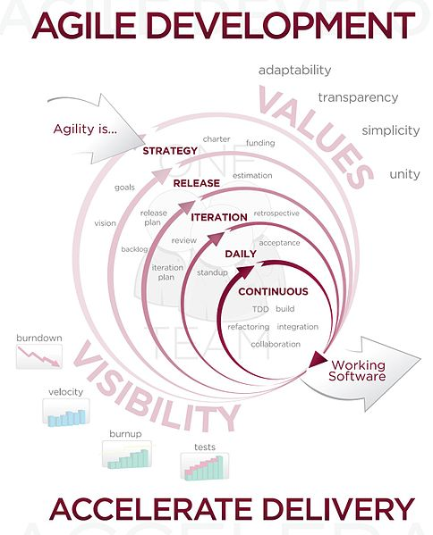
Agile Development

Slide 34
Recap….

